Slide 1
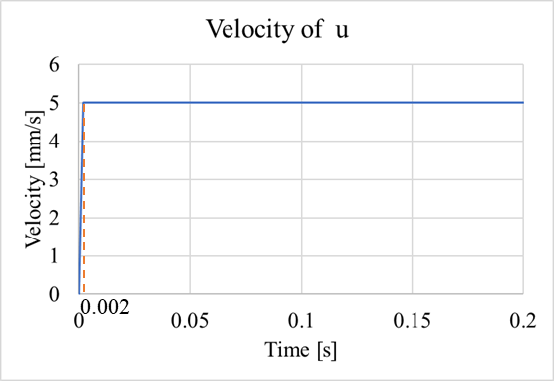
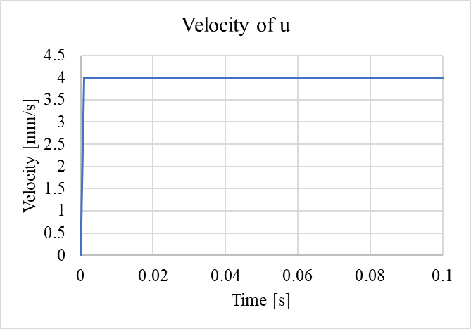
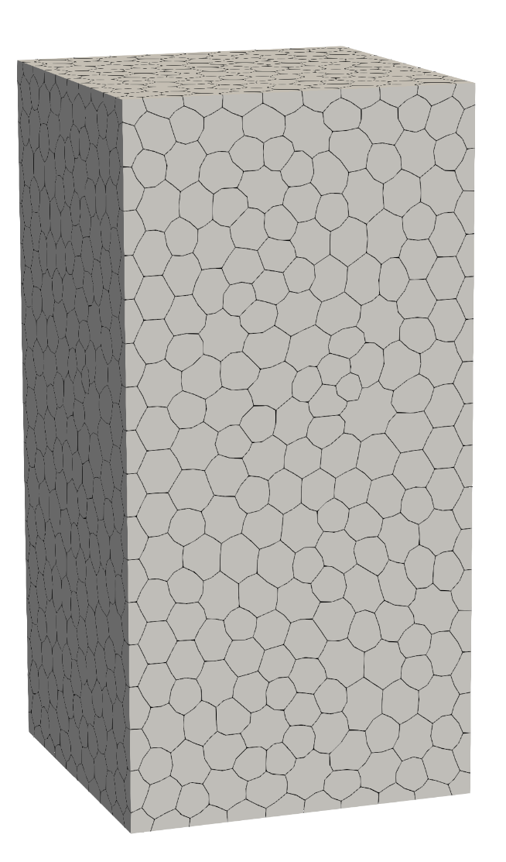
Unconfined Compression - Free
Size in XYZ: 100mm x 100mm x 200mm
RP1 (50, 50, 200):
(Central node at top)
dx = 0; dy = 0; dz = u;
rx = 0; ry = 0; rz = 0
RP2 (50, 50, 0):
(Central node at bottom)
dx = 0; dy = 0; dz = 0;
rx = 0; ry = 0; rz = 0
Tie:
RP1 -> nodes on the top (z=200)
RP2 -> nodes on the bottom (z=0)
dz; rx; ry are the same
Nodes on top:
(except RP1)
dz = u
rx = 0
ry =0
RP1
0.001
Total time is 0.2s.
Nodes on bottom:
(except RP2)
dz = 0
rx = 0
ry =0
Z
Y
X
RP2

Slide 2
Unconfined Compression - fix
Size in XYZ: 100mm x 100mm x 200mm
RP1 (50, 50, 200):
(Central node at top)
dx = 0; dy = 0; dz = u;
rx = 0; ry = 0; rz = 0
RP2 (50, 50, 0):
(Central node at bottom)
dx = 0; dy = 0; dz = 0;
rx = 0; ry = 0; rz = 0
Fixed case
Tie:
RP1 -> nodes on the top (z=200)
RP2 -> nodes on the bottom (z=0)
dx, dy, dz, rx, ry, rz are the same
Nodes on top:
(include RP1)
dx = 0
dy = 0
dz = u
rx = 0
ry = 0
rz = 0
RP1
0.001
Total time is 0.4s.
Nodes on bottom:
(except RP2)
dx = 0; dy = 0; dz = 0
rx = 0; ry = 0; rz = 0
Z
Y
X
RP2

Slide 3
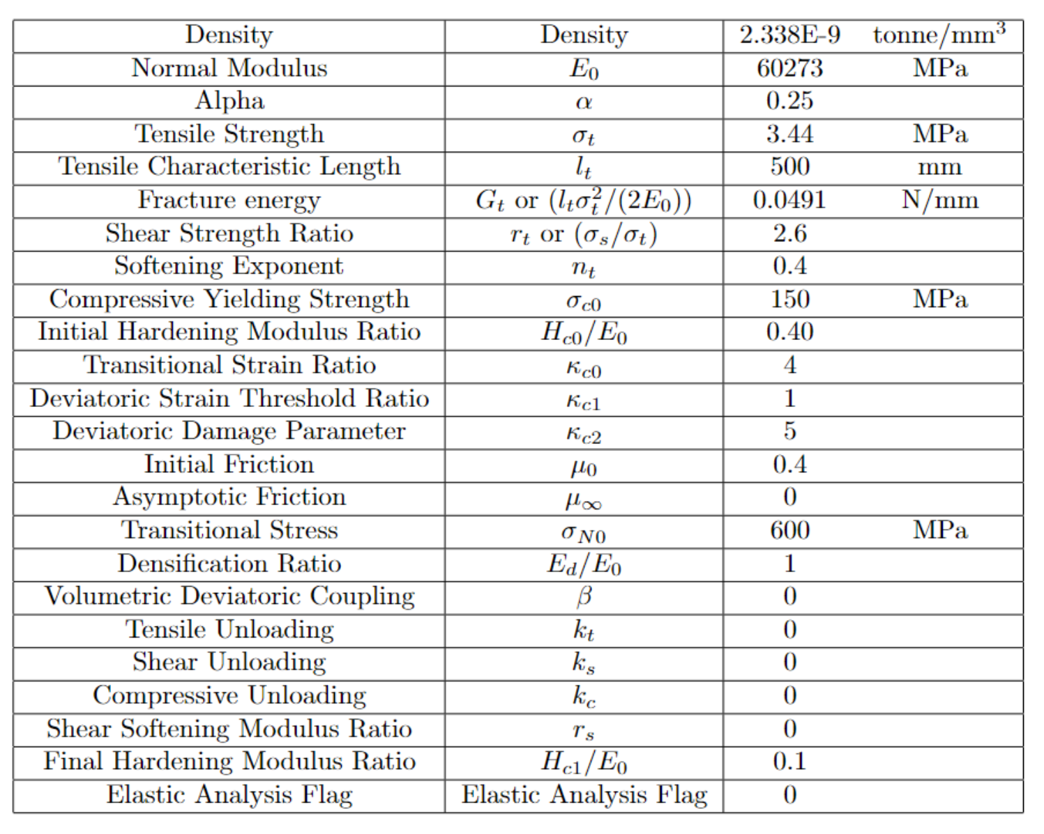
Material Property
Same as TPB test

Slide 4
